Slide 1
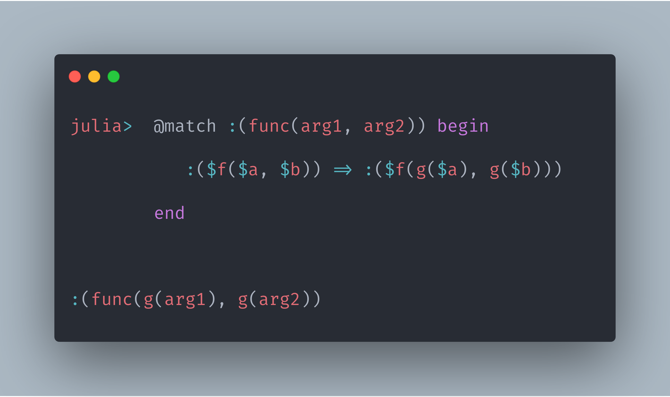
MLStyle.jl
Providing Functional Programming Infrastructures

Slide 2
What is MLStyle.jl
ML denotes “Meta Language” here.
Literally, it’s for providing you a chance to write ML Style codes in Julia, with the joy of functional programming.

Slide 3
Functional Programming Infrastructure
Briefly,
Extensible and efficient pattern matching
Data types, syntax extensions, etc.
Matching ASTs syntactically(☺ accidentally but nice to have)

Slide 4
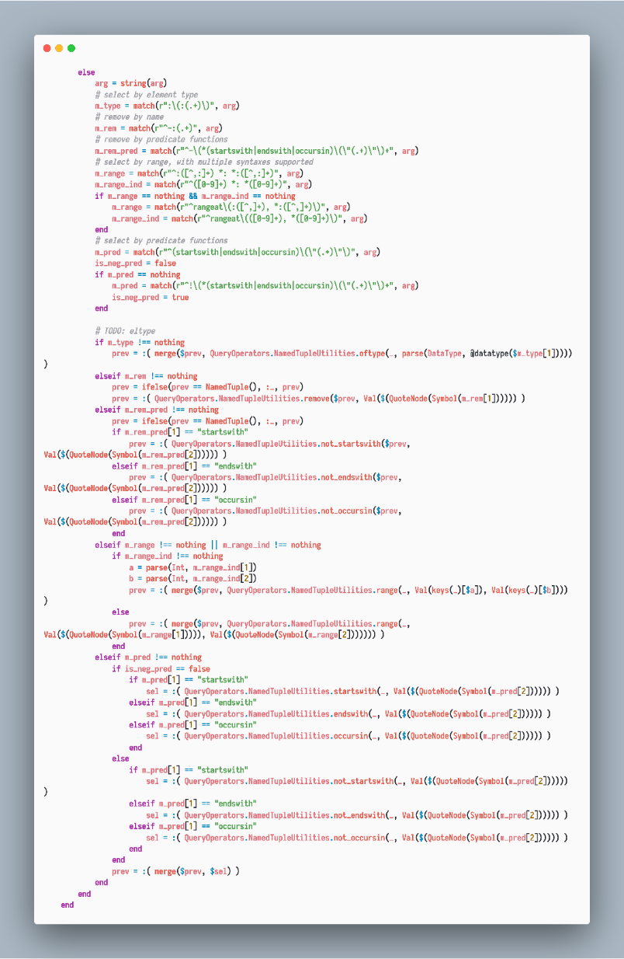
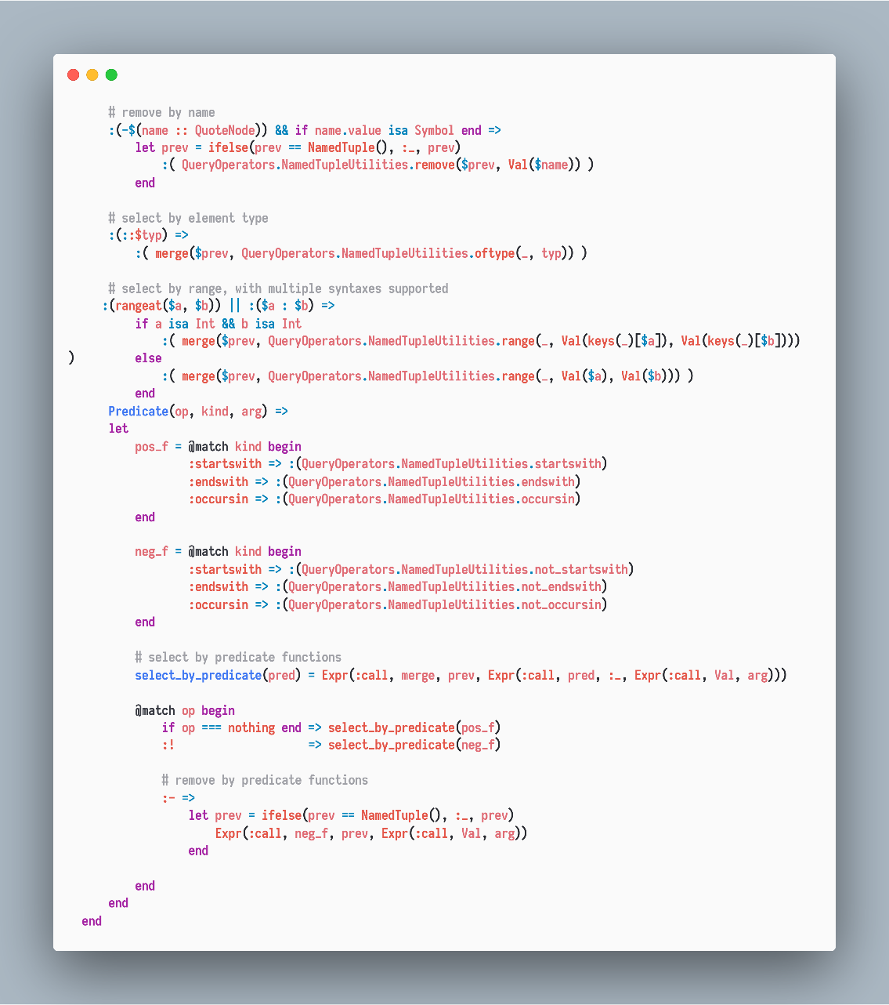
Query.jl PR#238
Use MLStyle.jl
Clean and Easier

Slide 5
Playful as well as Practical
Static type checking in 100 lines
Various routes to LISP syntax in 50 lines
Debugger in 200 lines
Parser generators
Extending Julia literals
Transpilers
…(check the repo MLStyle-Playground)
A WIP project Jui.jl is using MLStyle for the field of GUI.

Slide 6
Motivations
1. Used to be addicted to pattern matching
2. Noticed a valid syntax to express matching
3. Cannot do this easily in Python
4. The implementation could be efficient and easy
5. Don’t know there’s already Match.jl
6. Possible to define my own patterns, extensible and more
7. Get out of the pervasive limitations around programming

Slide 7
Motivations
Better is better. To gain better
Maintenance: writing maintainable code faster
Readability: writing readable code faster
Efficiency: writing faster code faster
Extensibility: writing extensible code faster

Slide 8
MLStyle.jl lets you
greatly simplify complex conditional logics
produce fast codes
produce extensible codes

Slide 9
Well, MLStyle.jl is fast, extensible and makes logics simpler?
I won’t talk about why pattern matching itself is good, because we’ll dip into this later with examples.
So, how to design and implement the pattern matching that is extensible and efficient?

Slide 10
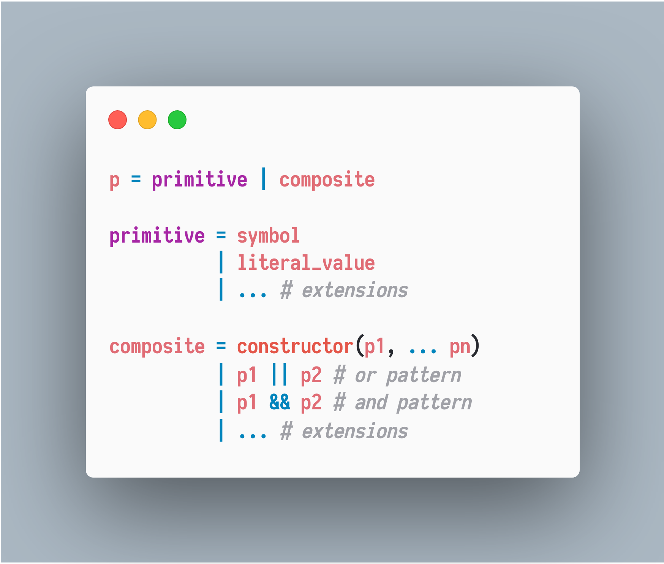
Basic Concepts

Slide 11
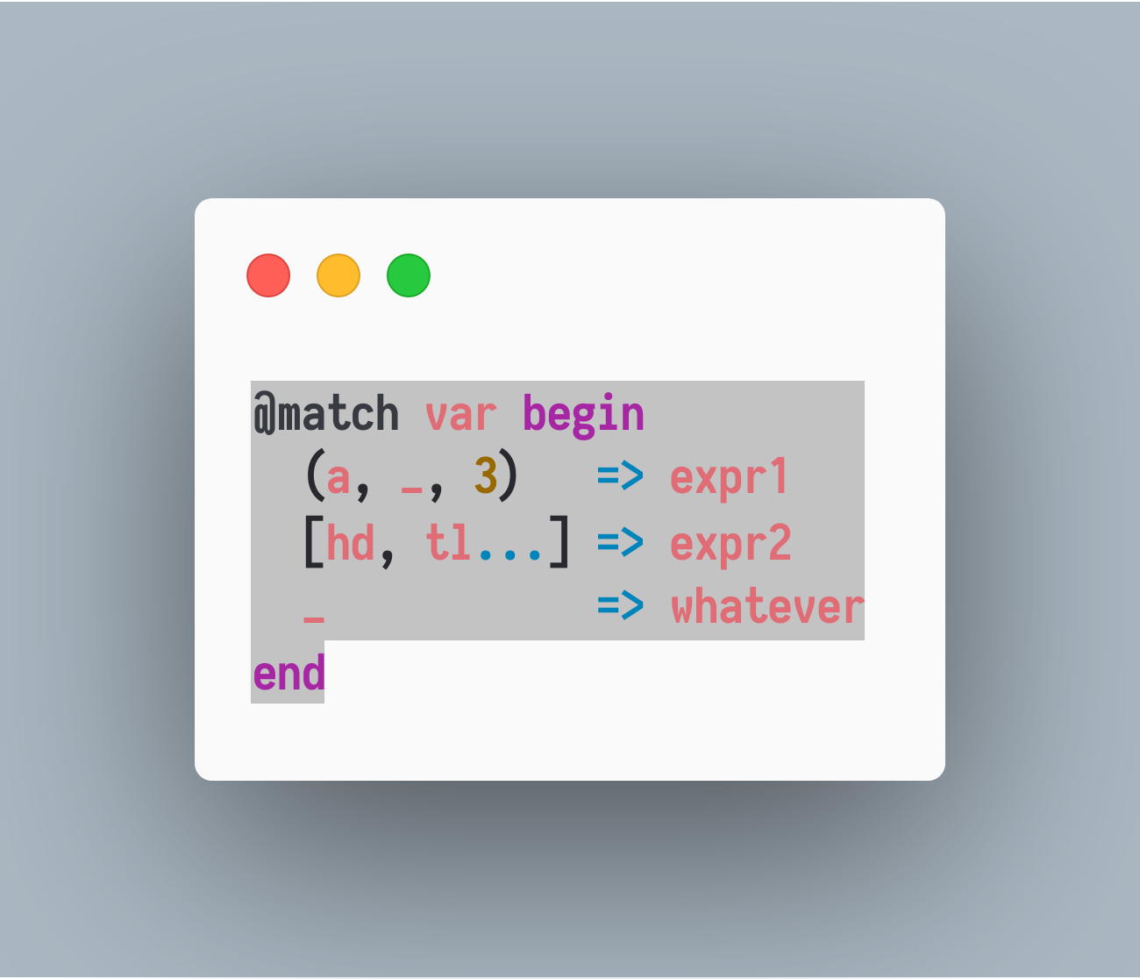
Case study

Slide 12
Decision Tree
Composite
primitive
var : Or
X : Tuple{T1, T2, T3}
Whatever
X : Vector
X : length >= 1
And block
X[2]: pass
view(X,2:end):
captured as tl
X[3]: === 3
X[1] :
captured as a
X[1] :
captured as hd
And block

Slide 13
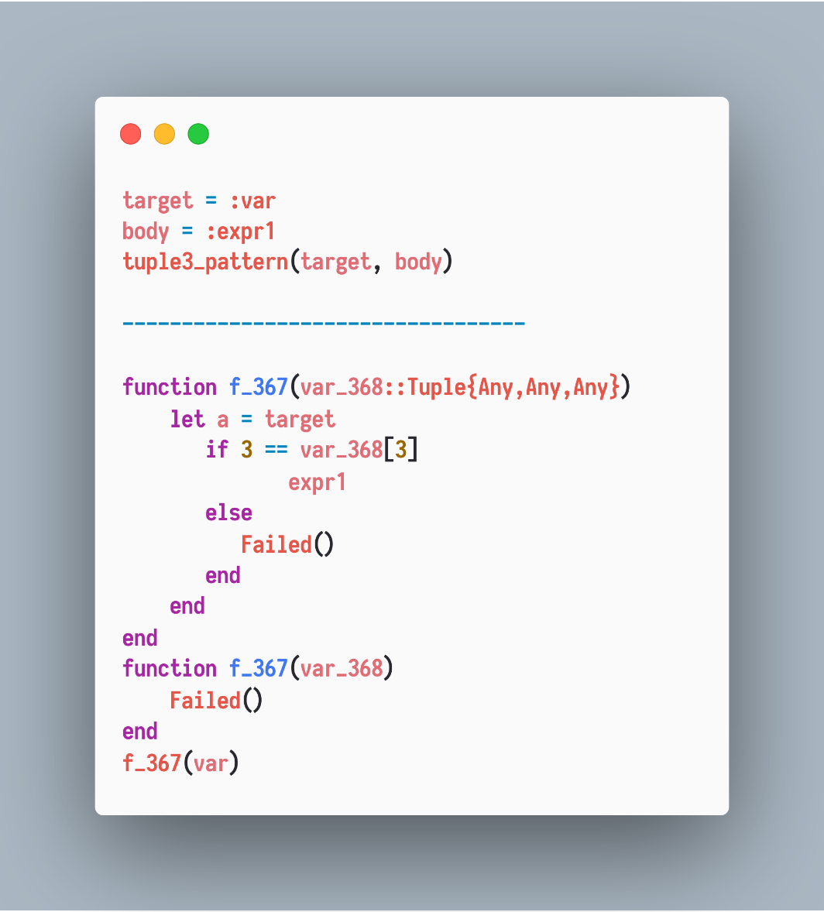
Decision Tree as Function
Composite
primitive
X : Tuple{T1, T2, T3}
X[1] :
captured as a
And block
X[2]: pass
X[3]: === 3

Slide 14
Decision Tree as Function
pattern(target, remainder) = generated_code

Slide 15
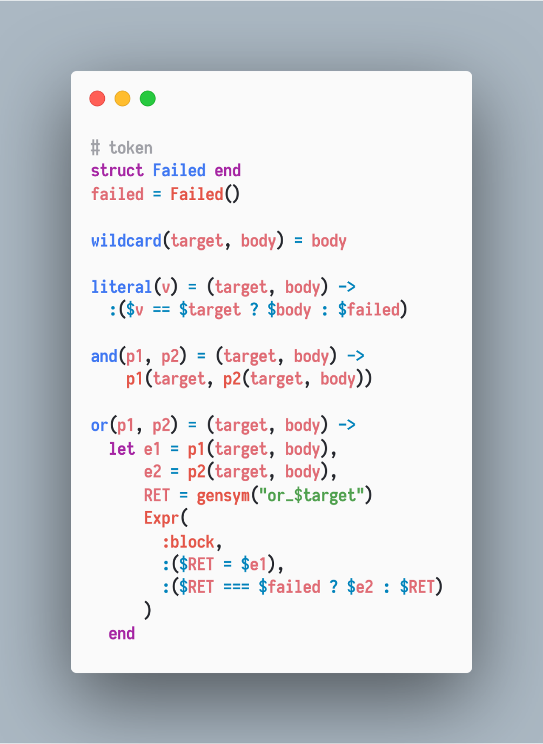
Decision Tree as Function

Slide 16
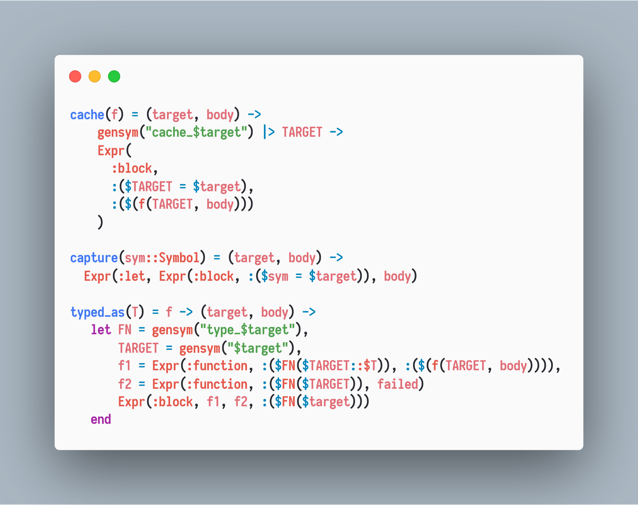
Decision Tree as Function

Slide 17
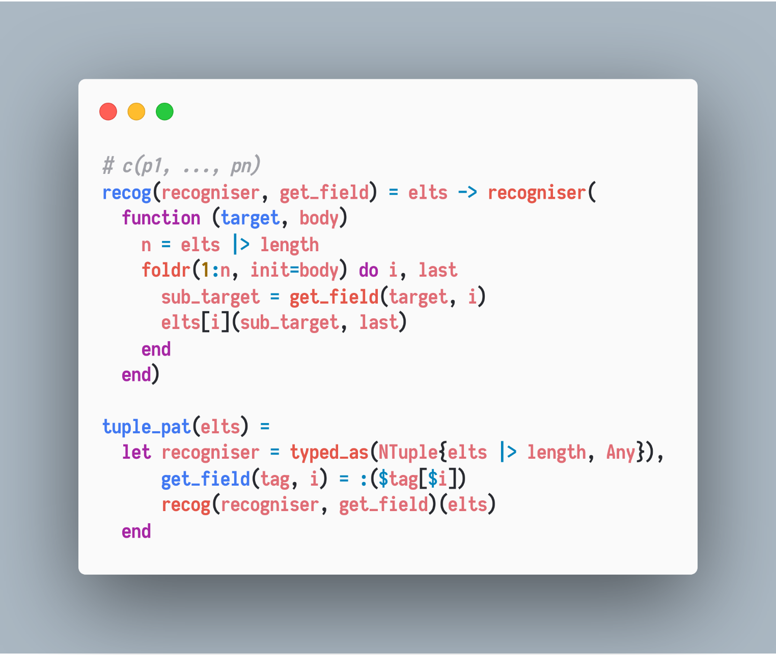
Decision Tree as Function
Constructor patterns/recognisers, e.g., tuple pattern

Slide 18
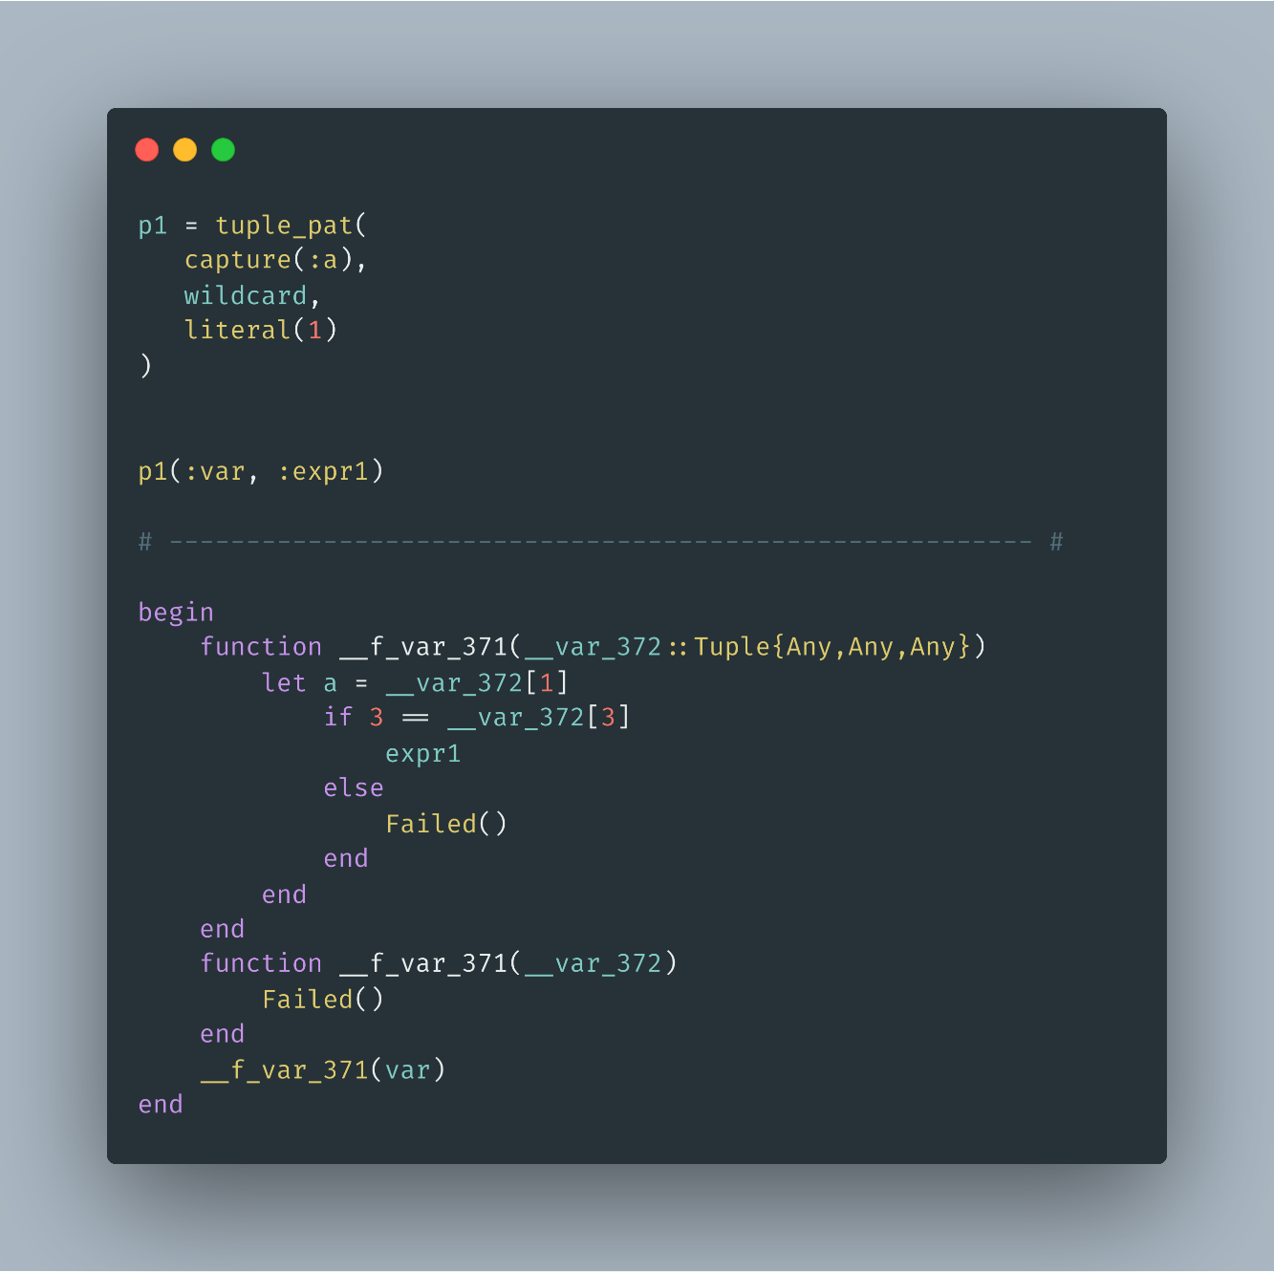
Decision Tree as Function

Slide 19
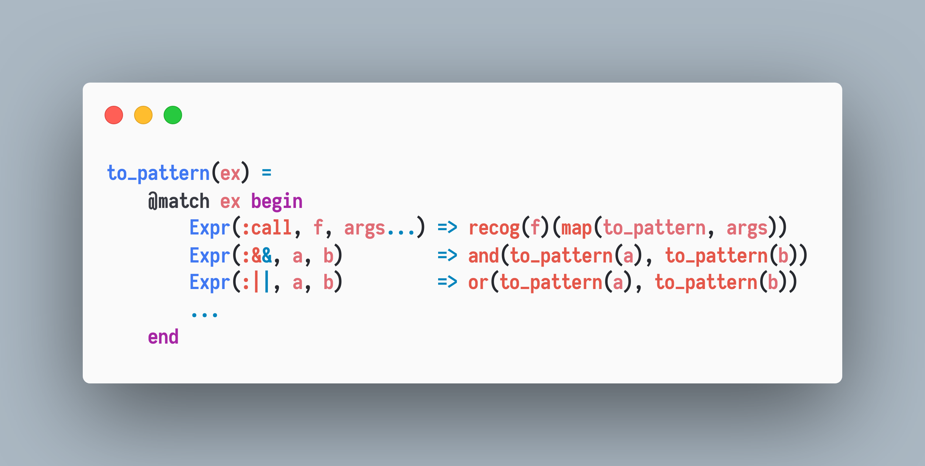
Pattern Matching Syntax
In terms of semantics,

Slide 20
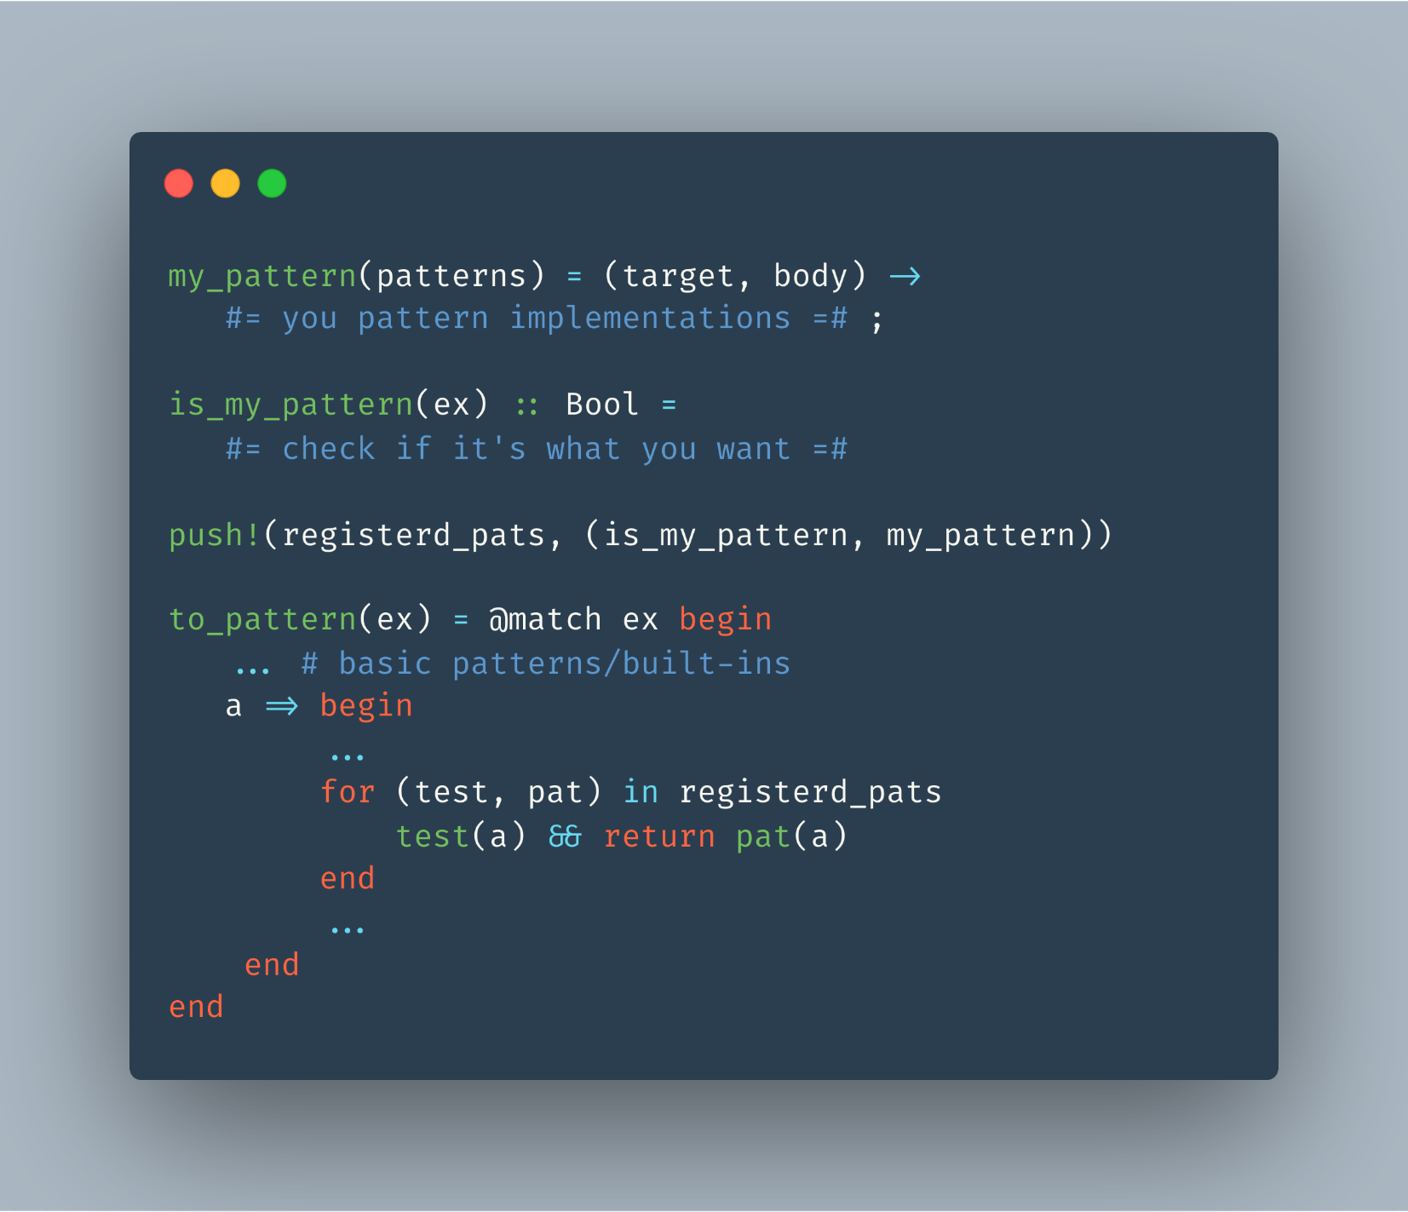
Extensible

Slide 21
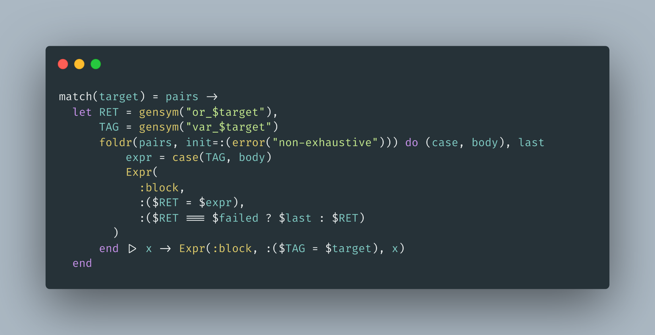
Efficient

Slide 22
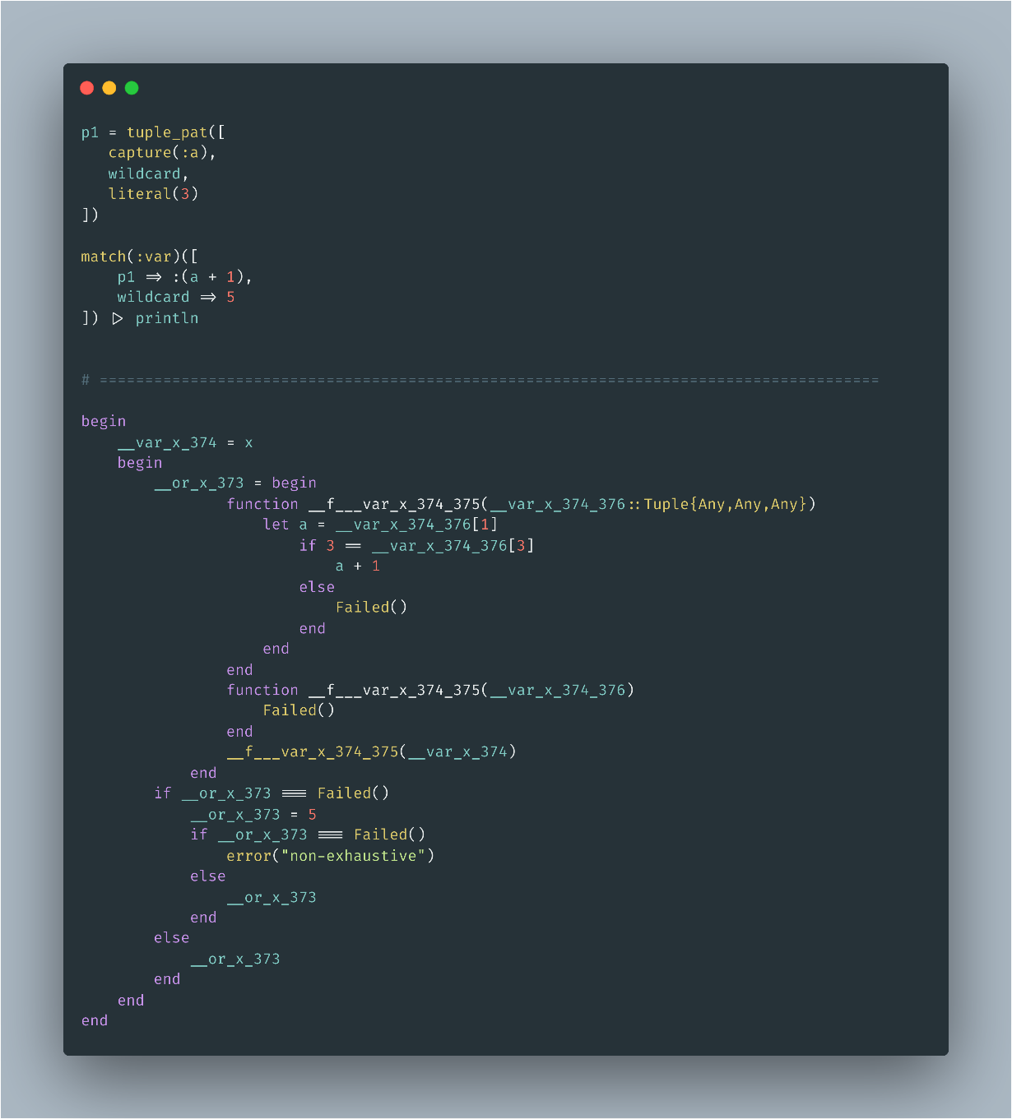
Efficient

Slide 23
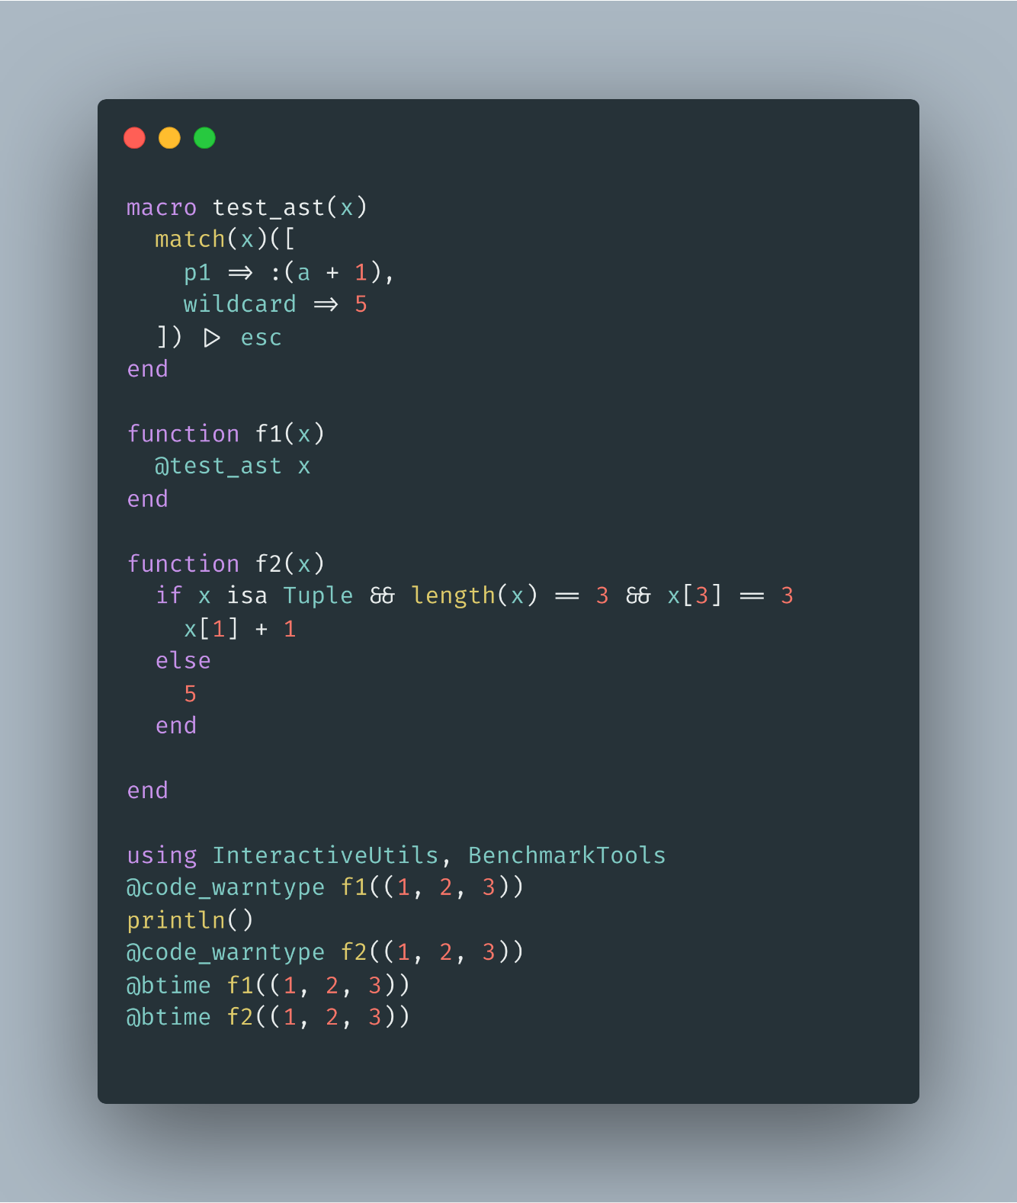
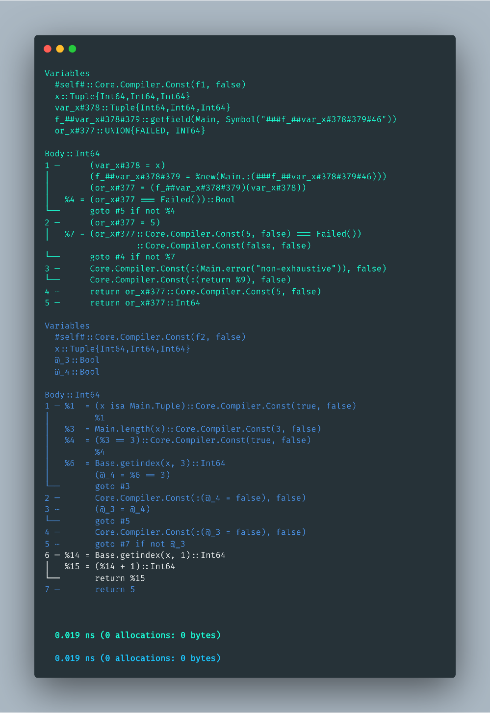
Efficient

Slide 24
The use of the singleton failed does hurt the performance in some cases. Match.jl uses nothing instead of a failed, thus despite of extensibility it’s still weaker(no exhaustive matching) but can be faster in a contrived case:
e.g., when dispatching is not static/cannot get specialized in compiling time.
P.S: Julia optimizes nothing particularly.

Slide 25
Additional Reasons for using MLStyle.jl
1. Frequent and compatible updates for incoming features
to fit the real world demands
2. Fast issue solving
3. I’m doing research in the concerned fields and I have rich skills on
the concerned topics
4. Planning to make MLStyle.jl as a dev-only dependency via
our bootstrap mechanism.
…

Slide 26
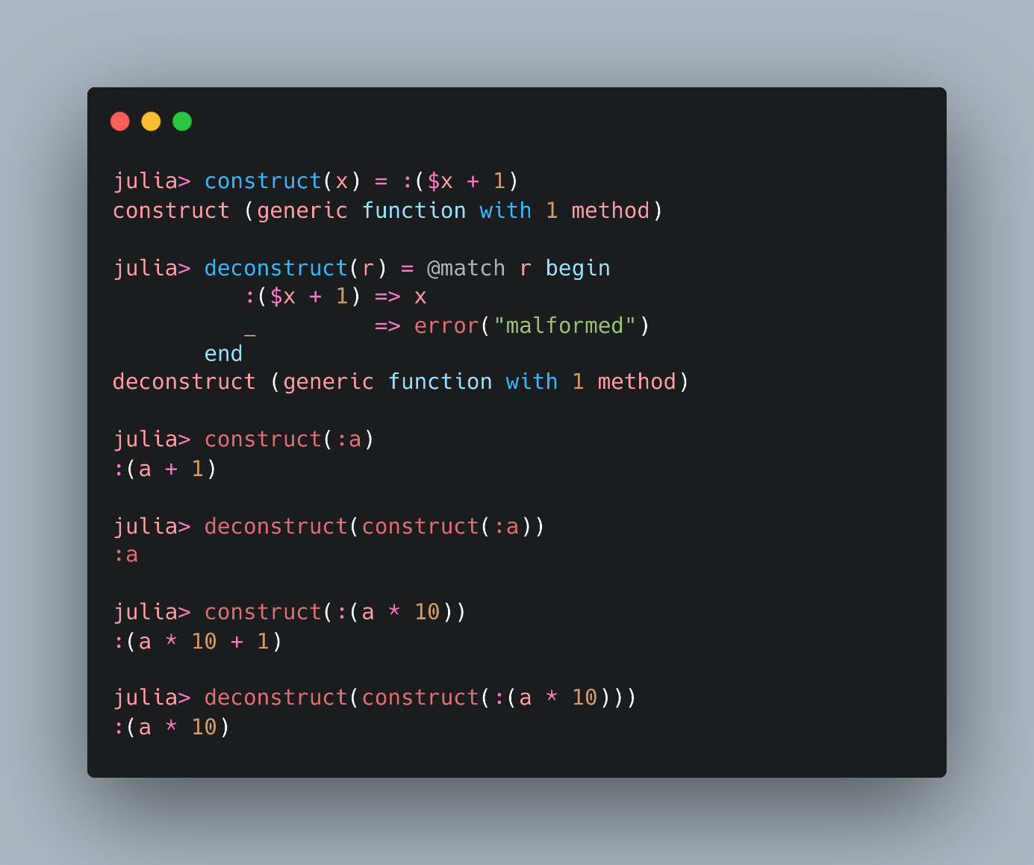
Matching ASTs Statically and Literally
As a feature requested by Roger Luo at MLStyle.jl#13 In Sep 2018, and got further developed since then.

Slide 27
Matching ASTs Statically and Literally
Core idea:
Deconstruct data just as
how they’re constructed
See more:
General Programming In Julia Language From An Advanced Standpoint

Slide 28
Examples
Debugger
Parsing, parsing expression generator
DSL/full featured programming languages
Py2JL.jl/Transpilers
Extending literal syntaxes
Query eDSL
Syntax extension
Static type checking for Julia (special thanks to Jonathan Bieler!)

Slide 29
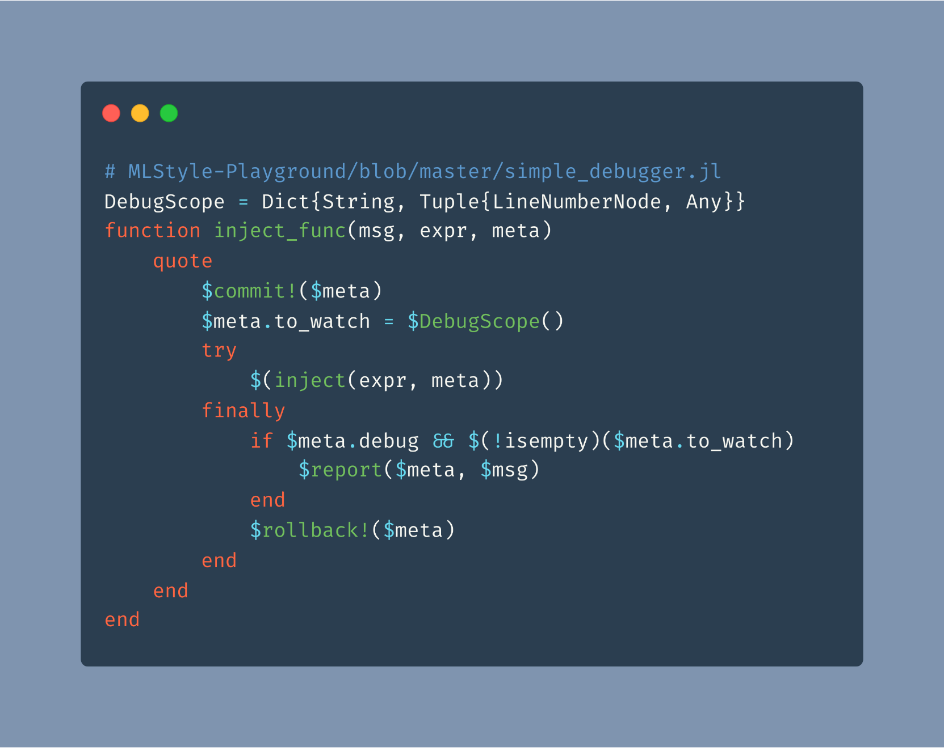
Examples – Debugger

Slide 30
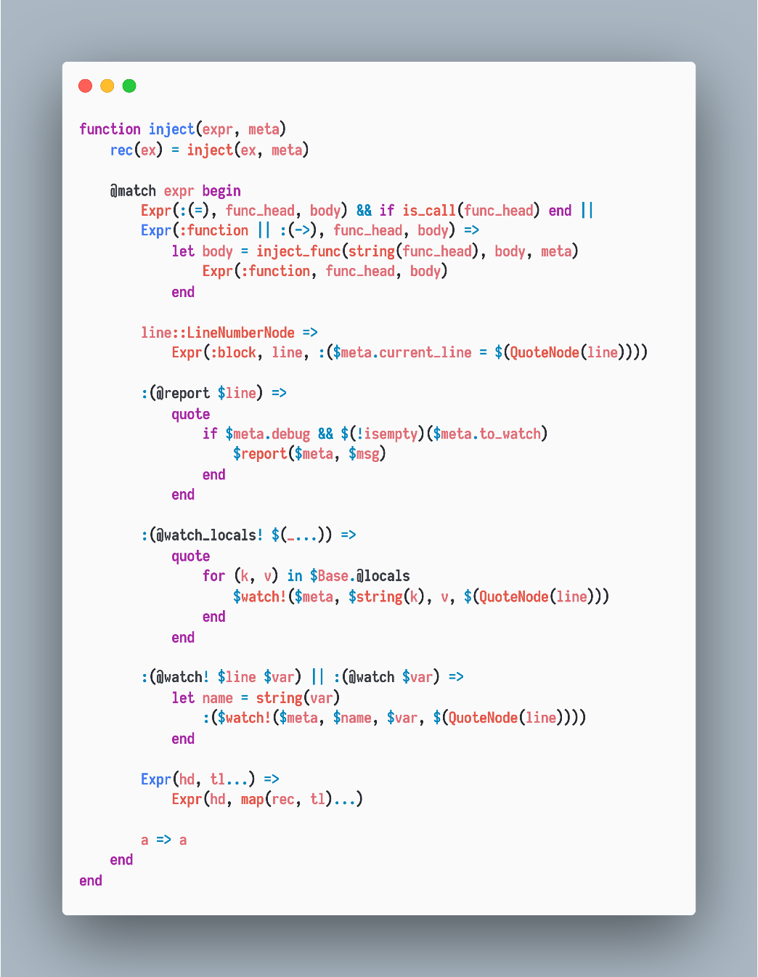
Examples – Debugger

Slide 31
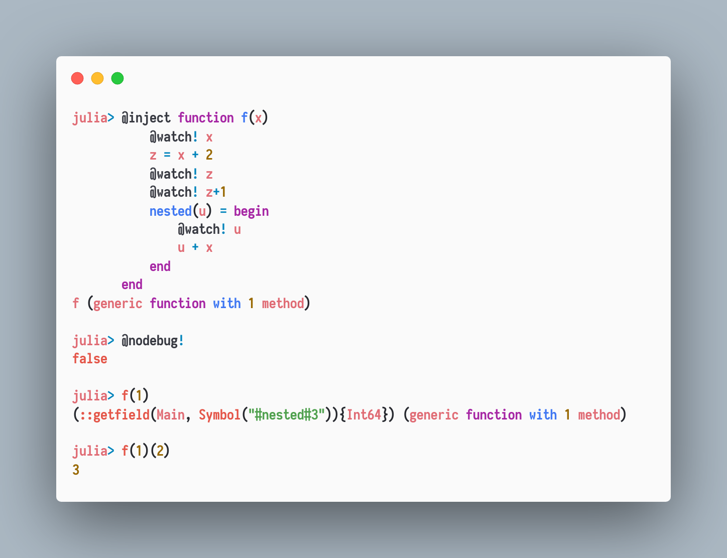
Examples – Debugger

Slide 32
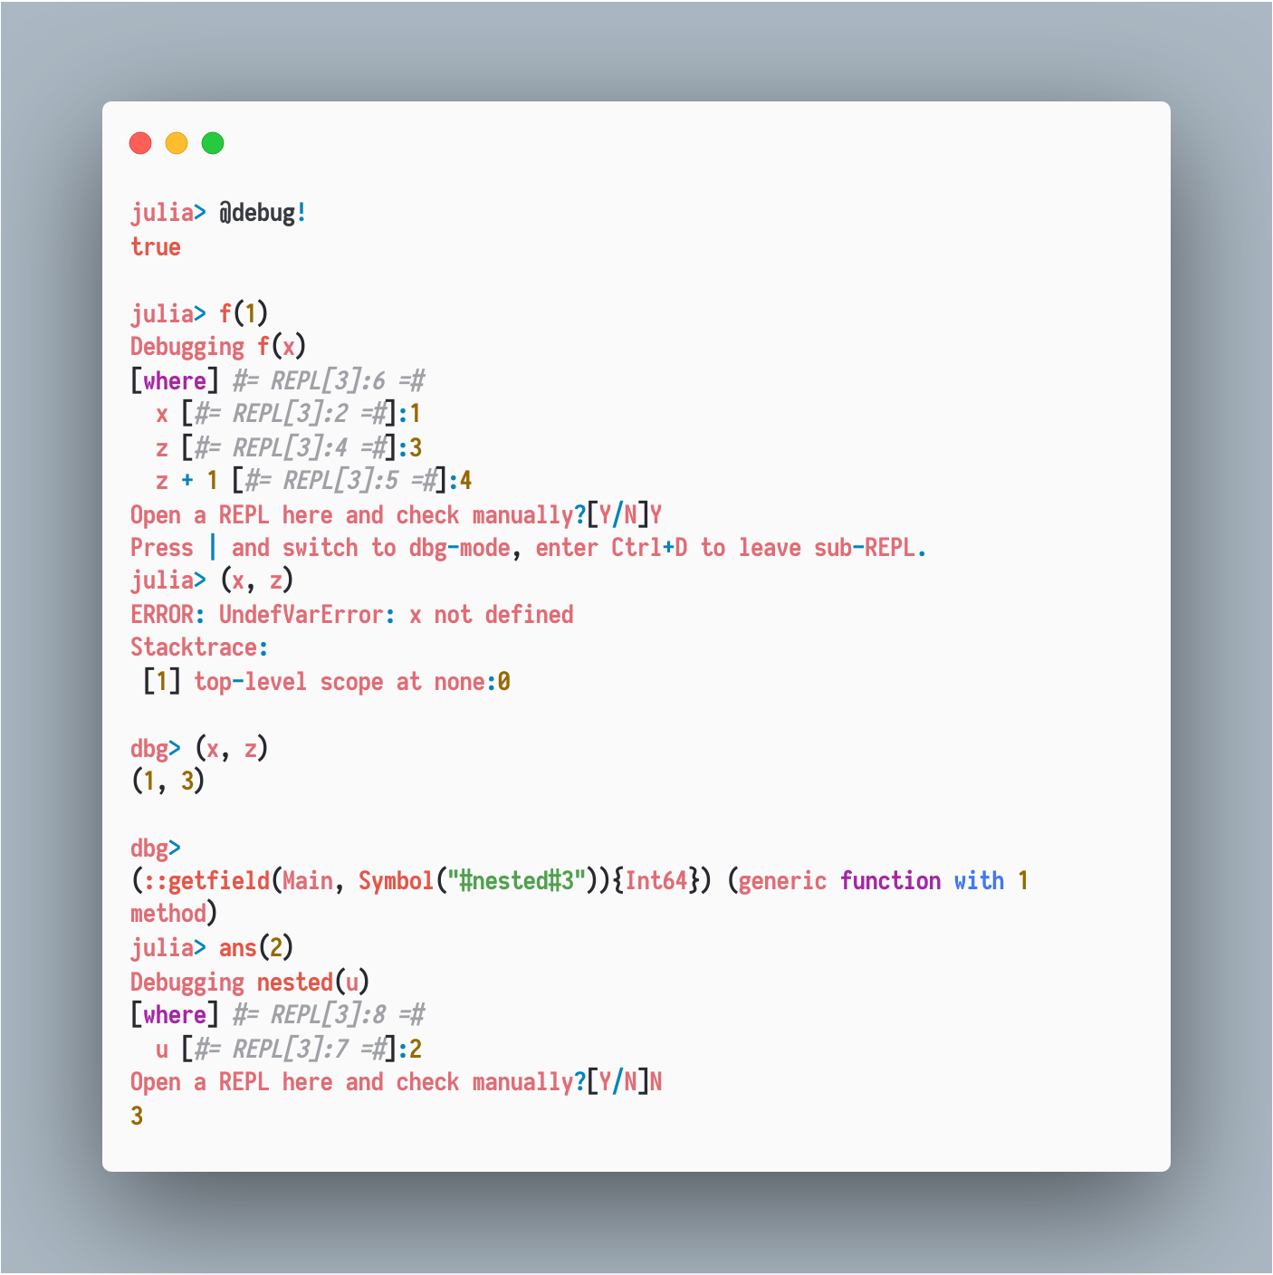
Examples – Debugger

Slide 33
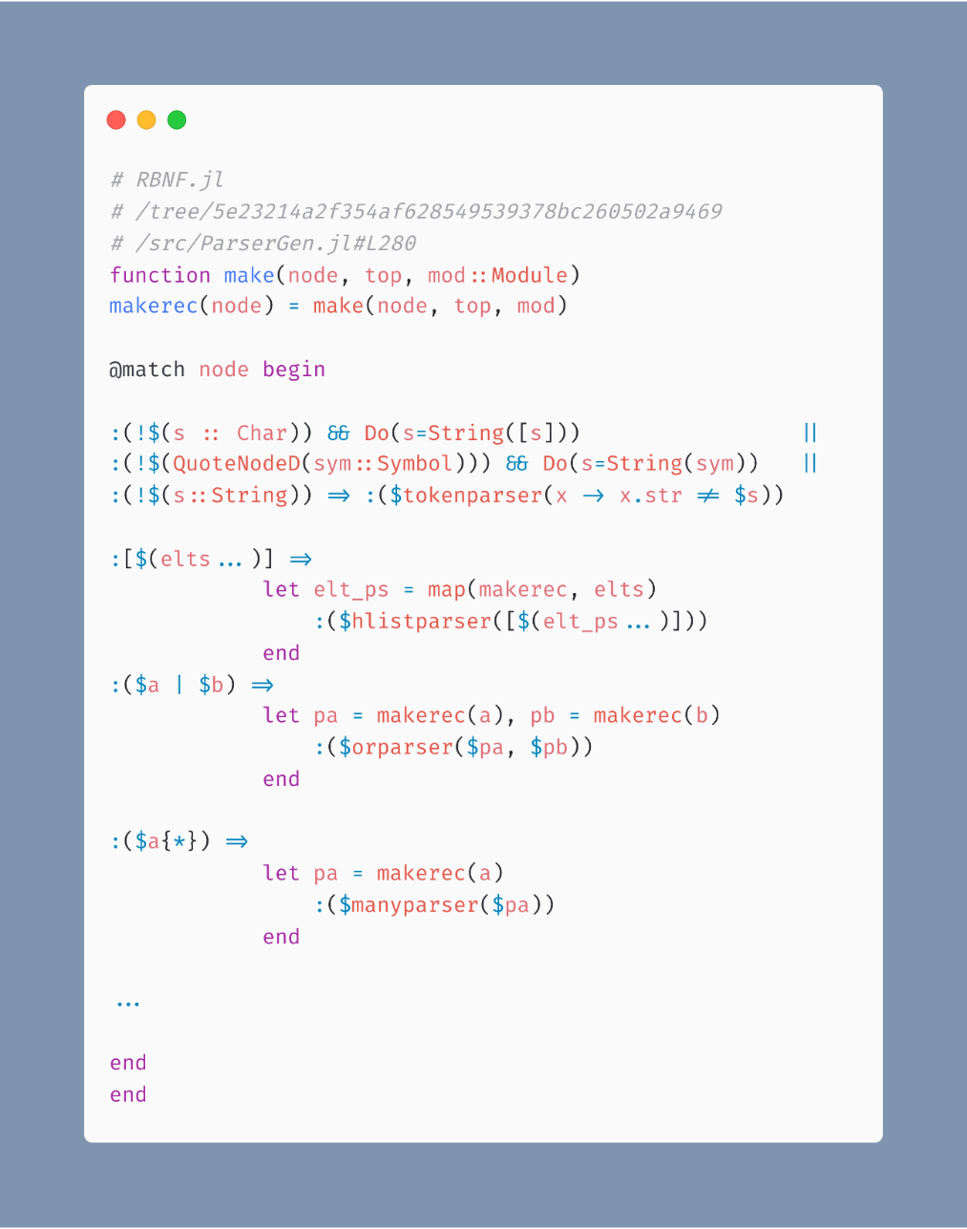
Examples - Parsing
RBNF.jl
Julia Syntaxes -> Parser Combinators

Slide 34
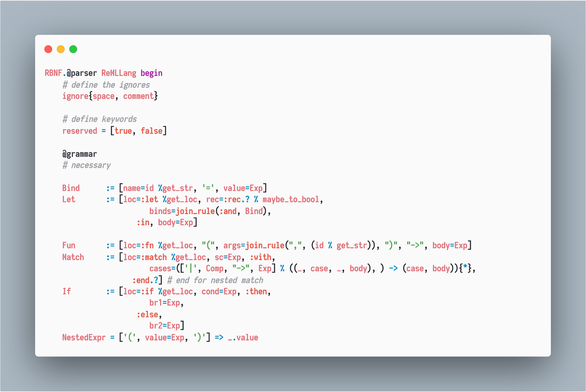
Examples - Parsing
Syntax-driven

Slide 35
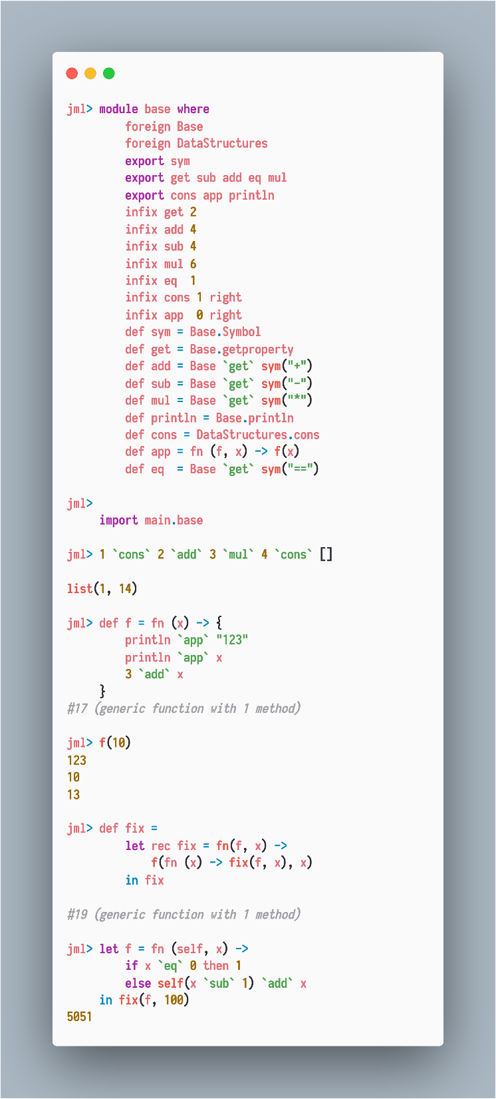
JML.jl
Examples - DSL
Parser from Example-Parsing section.
1. Custom precedences and associativities
2. Let bindings, let-rec bindings
…
Big thanks to Mason Protter for his ReplMaker.jl which I took advantage of to make the jml mode.

Slide 36
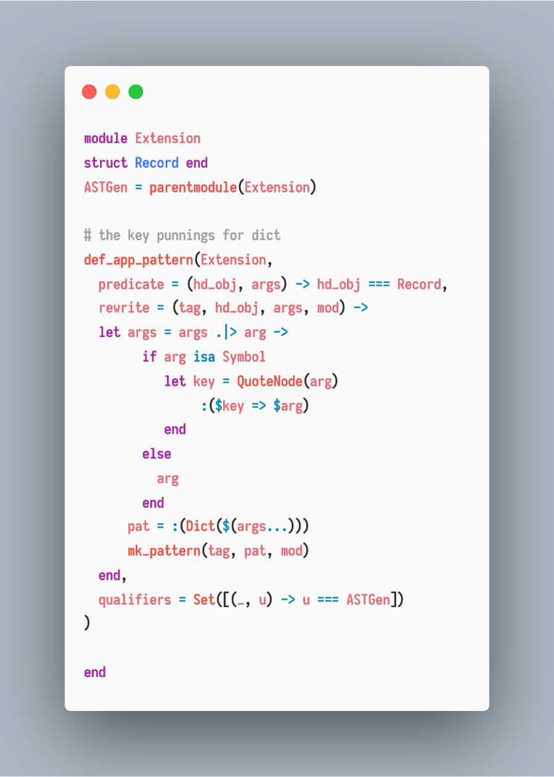
Examples – Py2Jl.jl
A custom pattern Record providing a more handy way to match Dict{Symbol, T}

Slide 37
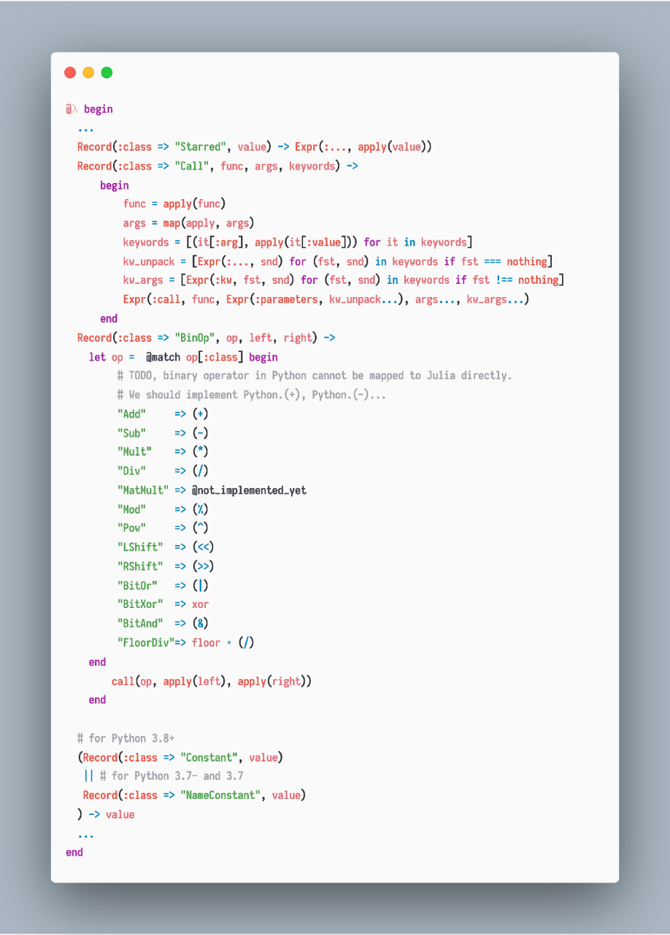
Examples – Py2Jl.jl

Slide 38
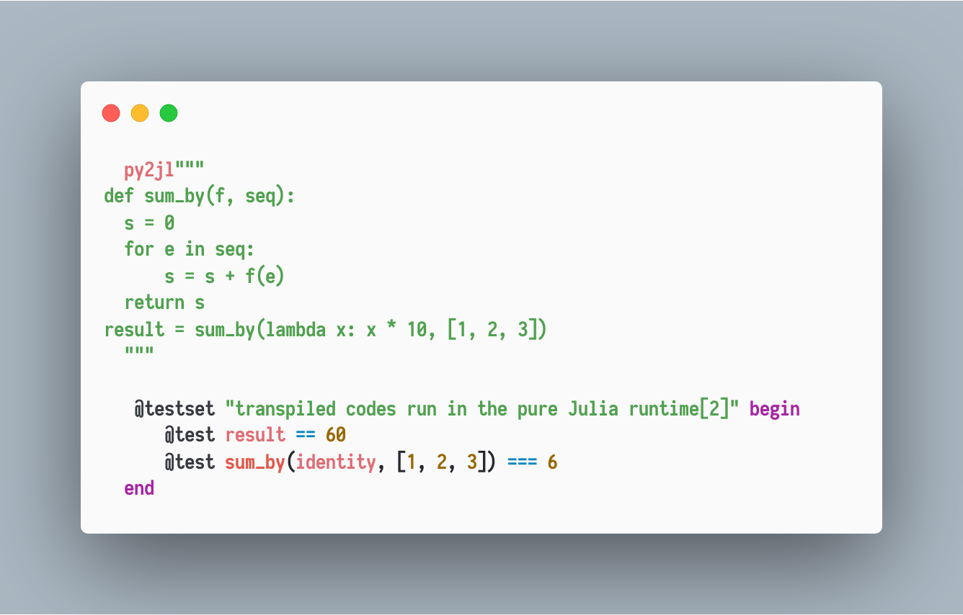
Examples – Py2Jl.jl

Slide 39
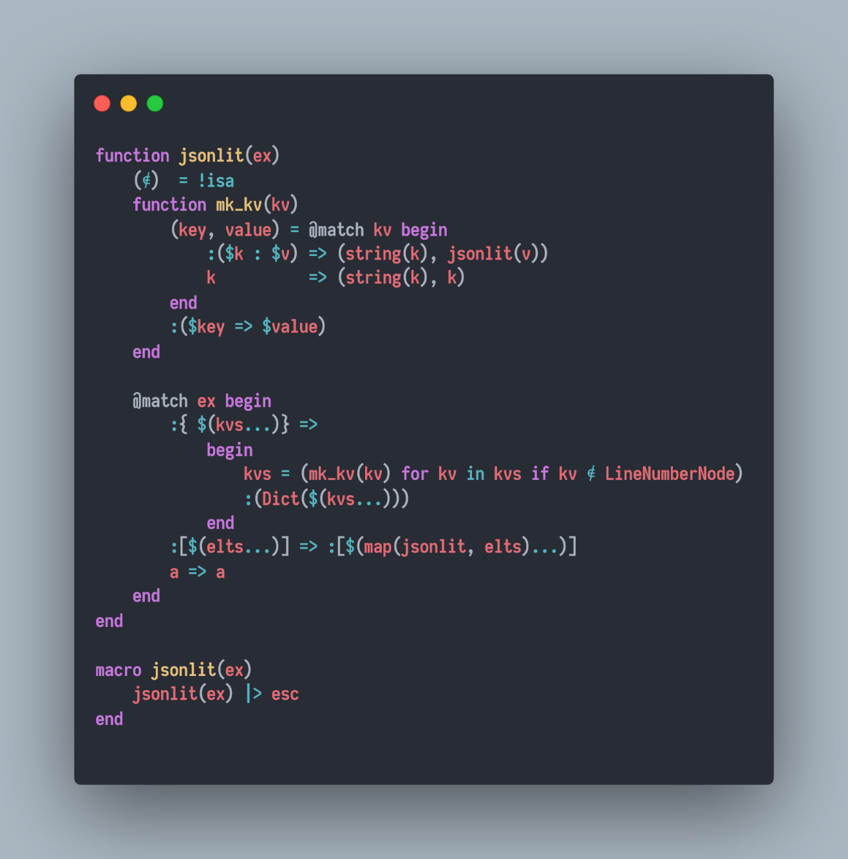
Examples - Extending literal syntaxes
JSONObjectLiteral.jl

Slide 40
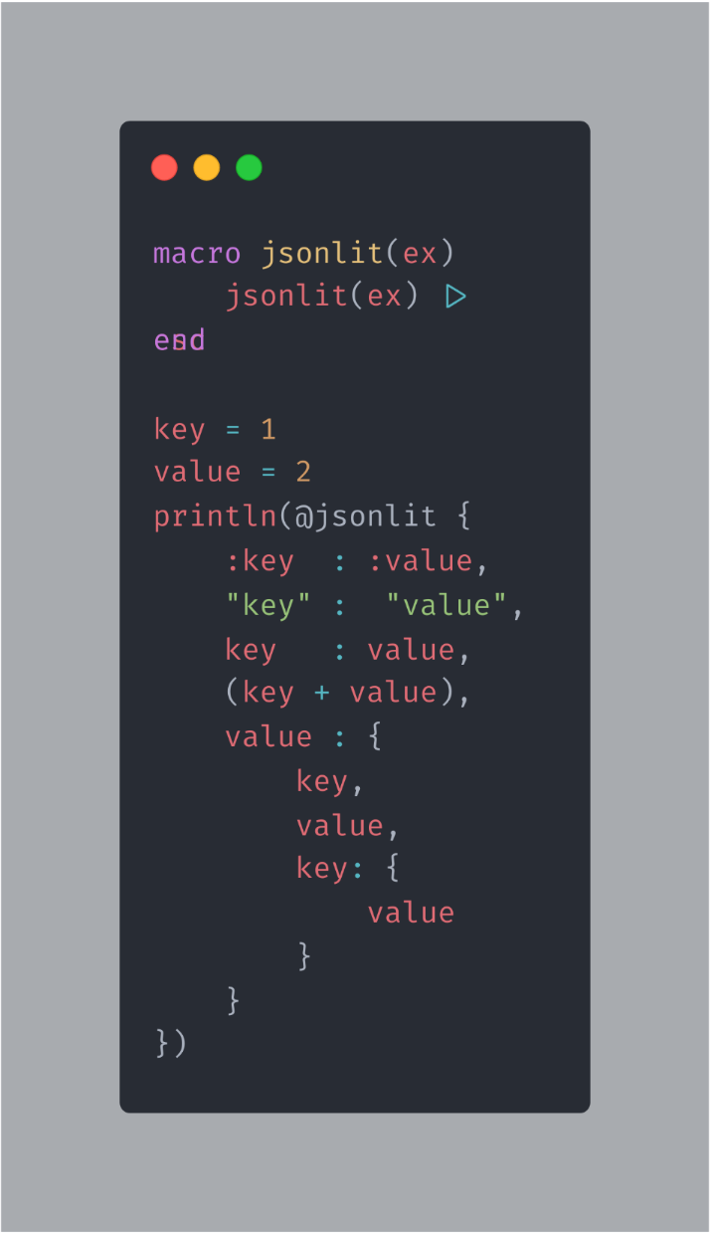
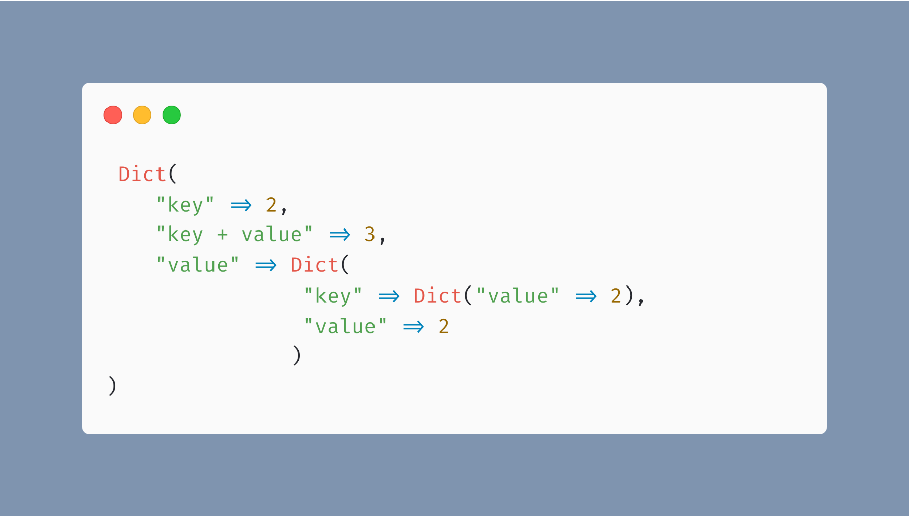
Examples - Extending literal syntaxes

Slide 41
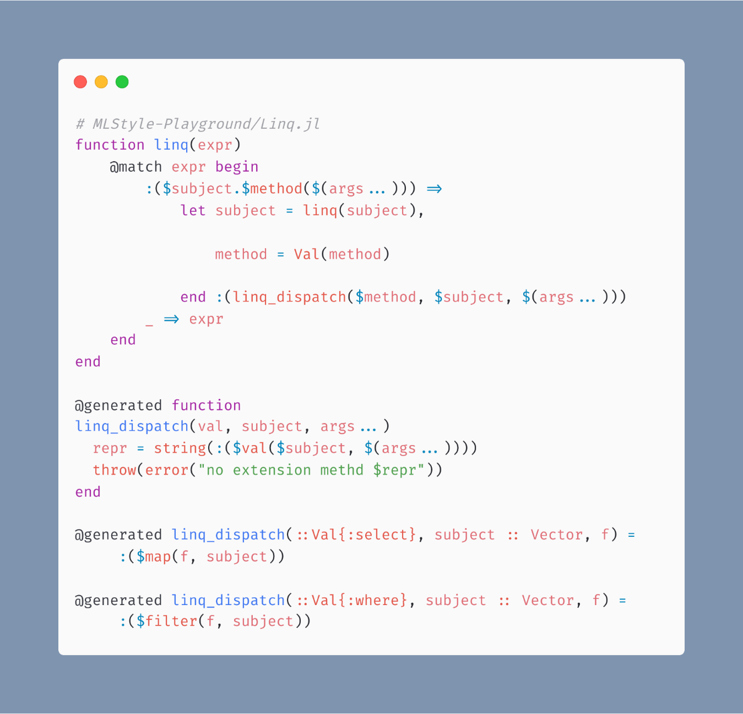
Examples – Query eDSL : Linq

Slide 42
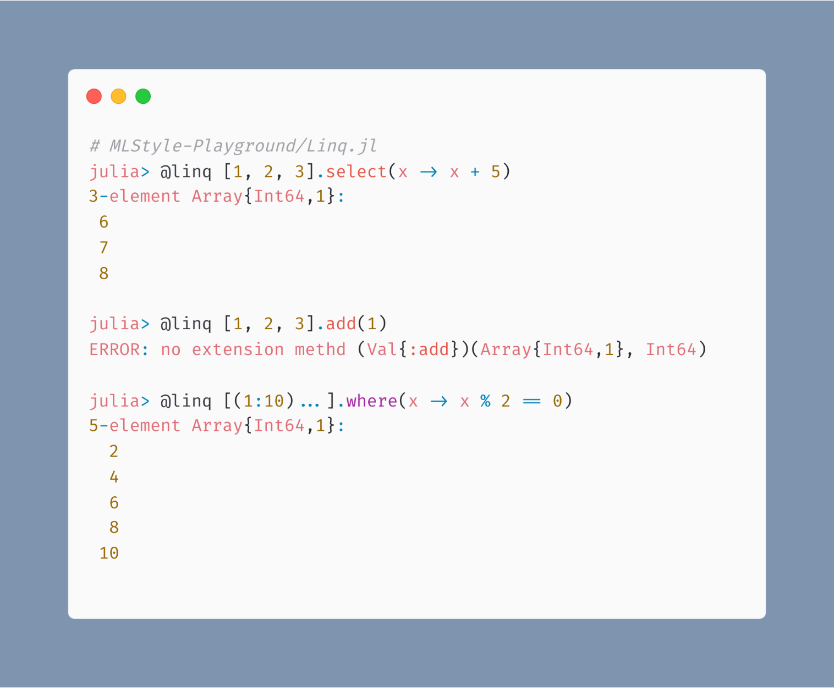
Examples – Query eDSL : Linq

Slide 43
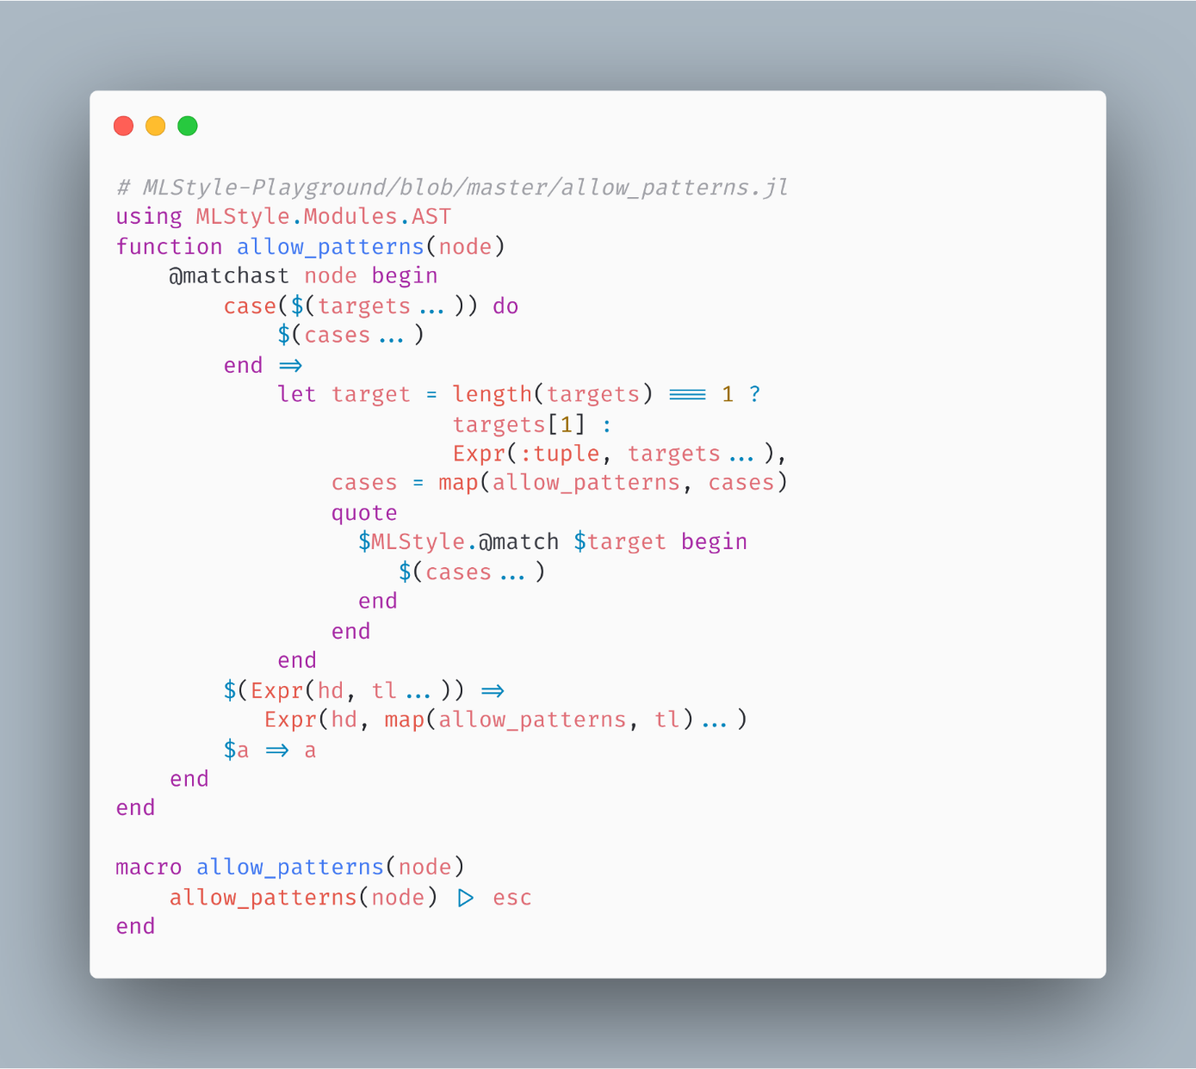
Examples – Syntax Extensions

Slide 44
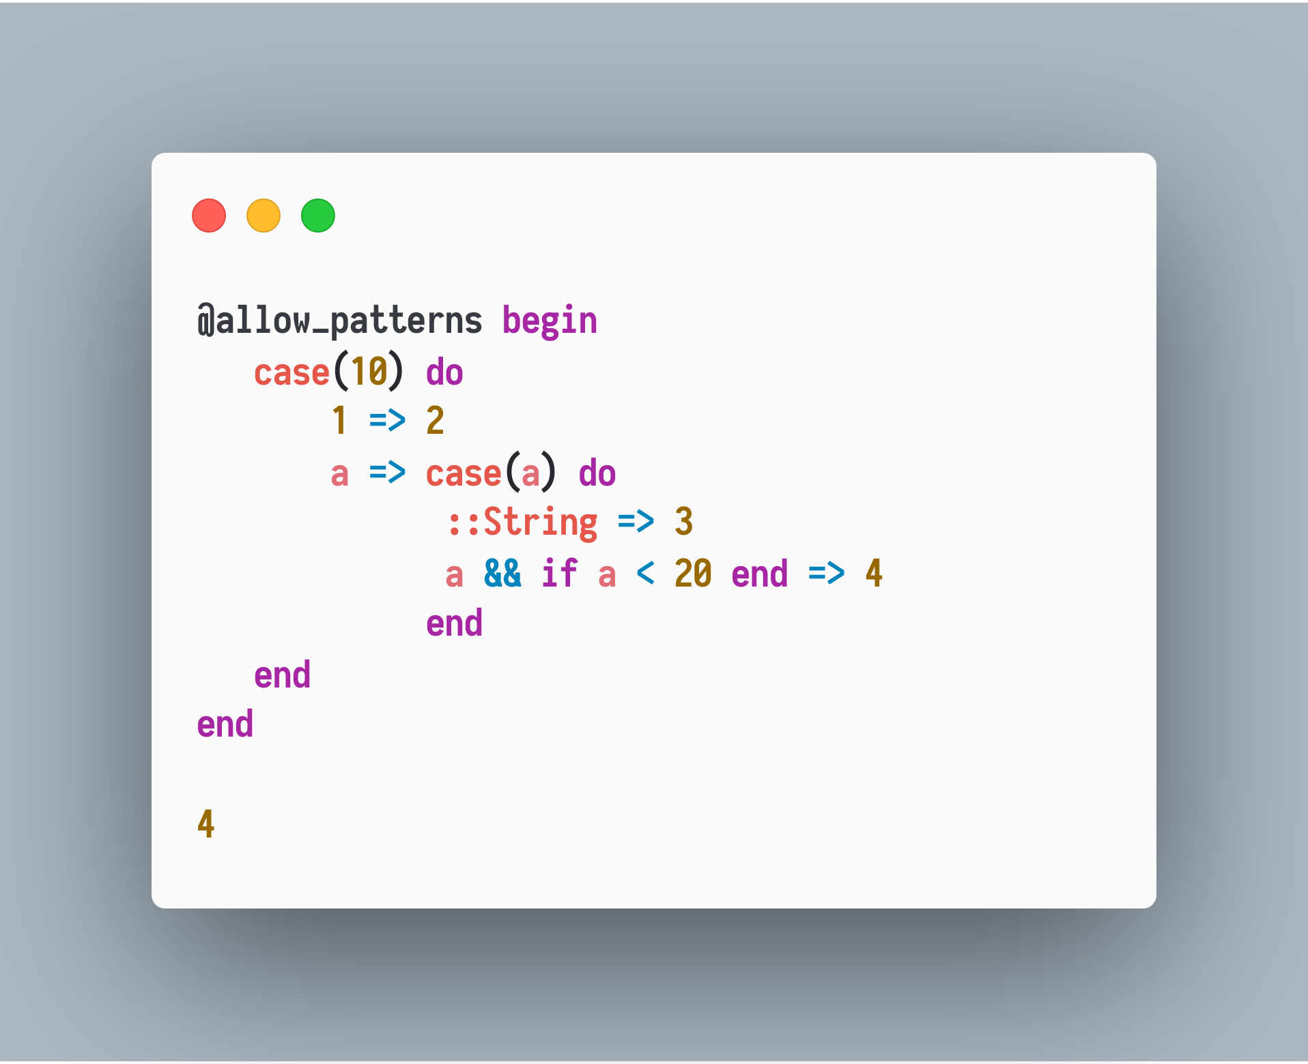
Examples – Syntax Extensions

Slide 45
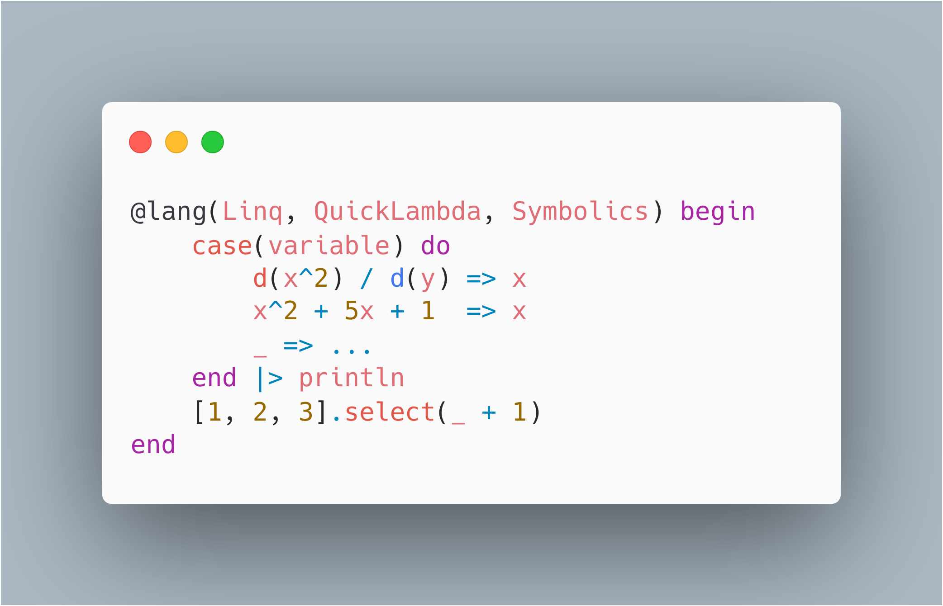
Examples – Syntax Extensions

Slide 46
Examples – Syntax Extensions

Slide 47
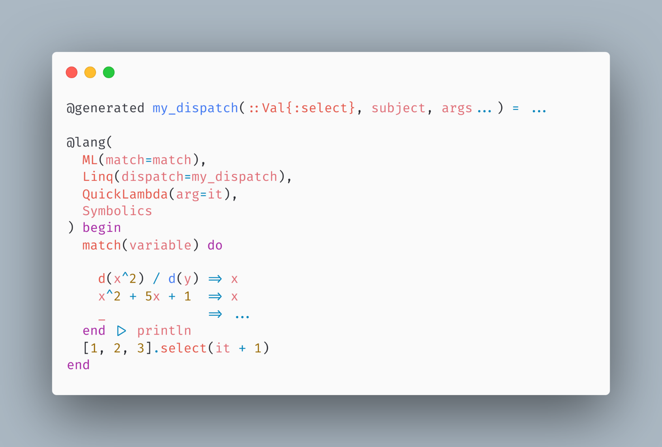
Examples – Syntax Extensions

Slide 48
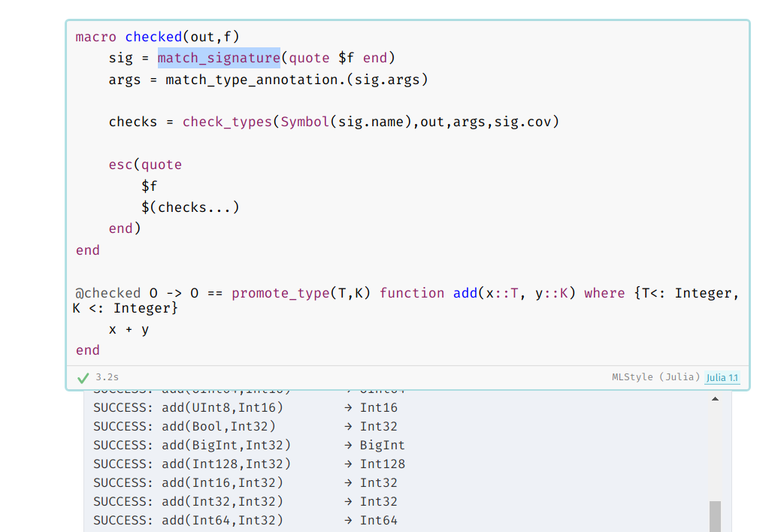
Examples – Static Type Checking
(By Jonathan Bieler)
https://nextjournal.com/jbieler/adding-static-type-checking-to-julia-in-100-lines-of-code/

Slide 49
Acknowledgements
Chad Scherrer, Arets Paeglis and Jeffrey Sarnoff encouraged me in the development of MLStyle.jl; Mason Protter provided an amazing approach for me to make REPLs in Julia; Jeffrey Sarnoff reviewed my slides with lots of constructive notes; People active in Julia community made a cool technical environment.
Roger Luo and JuliaCN, who gave me the chance to give a talk here.
The main contributors listed in https://github.com/thautwarm/MLStyle.jl/blob/master/acknowledgements.txt
My parents, who support me in every aspect of my life.
Prof. Oleg Kiselyov and Prof. Yukiyoshi Kameyama who helped me out of the impediment of getting further educations, which made it possible for me to spend more time with open source projects.

Slide 50
Contact
Slack Julia: Taine Zhao, woclass, Roger-luo
discourse.juliacn.com: thautwarm, woclass, Roger
discourse.julialang.org: thautwarm, woclass, Roger-luo
Julia中文社区 QQ: 316628299

